Slide 1
E/R Modeling
Syed Nasir Mehdi
Based on Chapter 3; Modern Database Management 6th Edition
Jeffrey A. Hoffer, Mary B. Prescott, Fred R. McFadden

Slide 2
SDLC Revisited – Data Modeling is an Analysis Activity
(figures 2.4, 2.5)
Project Identification
and Selection
Purpose –thorough analysis
Deliverable – functional system specifications
Project Initiation
and Planning
Analysis
Logical Design
Physical Design
Database activity –
conceptual data modeling
Implementation
Maintenance

Slide 3
Business Rules
Statements that define or constrain some aspect of the business
Assert business structure
Control/influence business behavior
Expressed in terms familiar to end users
Automated through DBMS software

Slide 4
A Good Business Rule is:
Declarative – what, not how
Precise – clear, agreed-upon meaning
Atomic – one statement
Expressible – structured, natural language
Distinct – non-redundant
Business-oriented – understood by business people

Slide 5
E-R Model Constructs
Entity instance - person, place, object, event, concept (often corresponds to a row in a table)
  Entity Type – collection of entities (often corresponds to a table)
Attribute - property or characteristic of an entity type (often corresponds to a field in a table)
Relationship instance – link between entities (corresponds to primary key-foreign key equivalencies in related tables)
  Relationship type – category of relationship…link between entity types
© Prentice Hall, 2002
Notes:
2

Slide 6
Entities
Any real-world thing (person, place, object, concept, activity) about which an enterprise records data
Entities are named with a noun
© Prentice Hall, 2002

Slide 7
Entities
An entity instance is a single identifiable real-world thing, e.g., Jack Spratt
An entity type is a set of entity instances sharing the same common properties (‘attributes’), characterized by:
  Name - a noun, e.g., EMPLOYEE
  Description - defines which instances belong to the entity type
  Identifier - a property (or a joint set of properties) which uniquely identify entity instances
© Prentice Hall, 2002

Slide 8
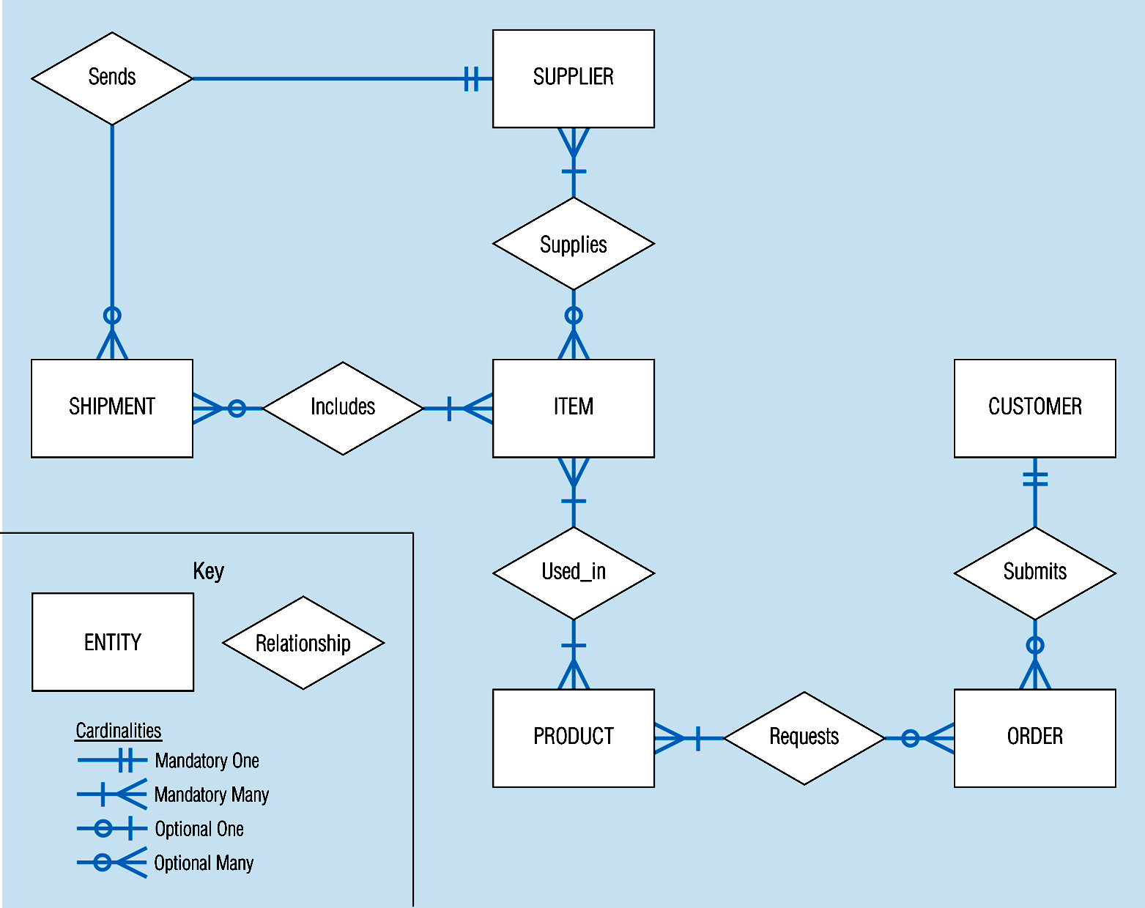
Sample E-R Diagram (figure 3-1)
© Prentice Hall, 2002
Notes:
3

Slide 9
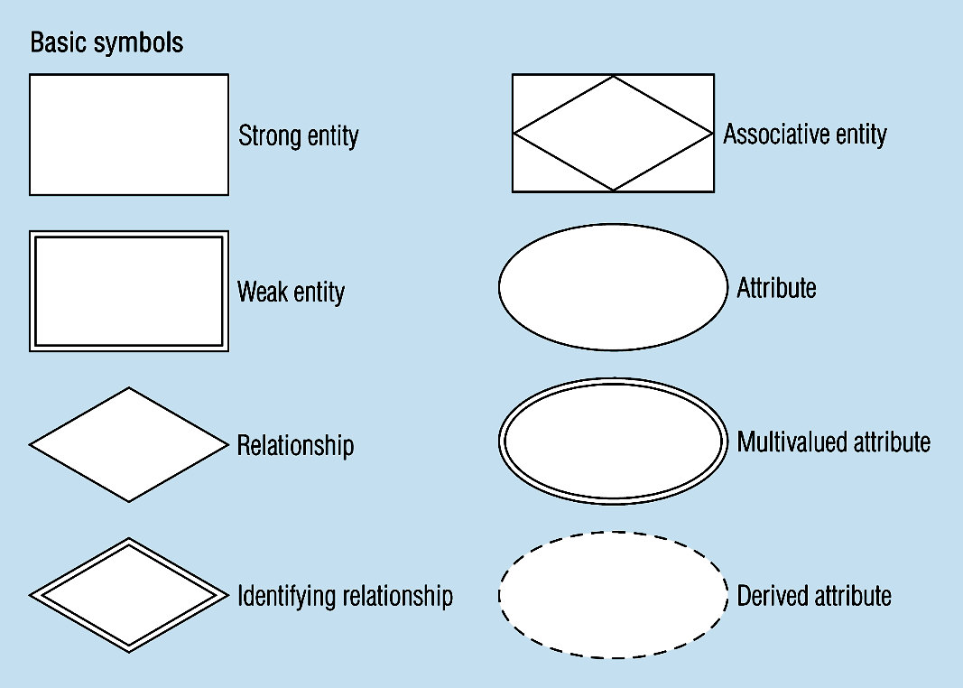
Figure 3-2 -- Basic E-R Notation
A special entity that is also a relationship
Entity symbols
Attribute symbols
Relationship symbols
© Prentice Hall, 2002
Notes:
8

Slide 10
What Should an Entity Be?
SHOULD BE:
  An object that will have many instances in the database
  An object that will be composed of multiple attributes
  An object that we are trying to model
  Must have an identifier
SHOULD NOT BE:
  A user of the database system
  An output of the database system (e.g. a report)
© Prentice Hall, 2002

Slide 11
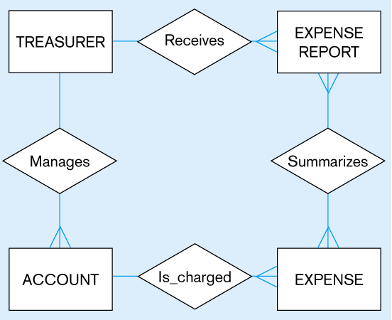
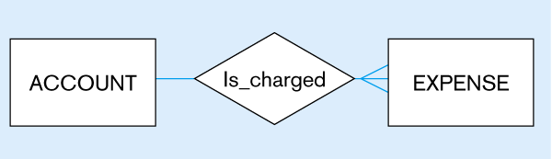
Figure 3-4
Inappropriate entities
System user
System output
Appropriate entities
© Prentice Hall, 2002

Slide 12
Attributes
Attribute - property or characteristic of an entity type
Classifications of attributes:
  Simple versus Composite Attribute
  Single-Valued versus Multivalued Attribute
  Stored versus Derived Attributes
  Identifier Attributes
© Prentice Hall, 2002
Notes:
5

Slide 13
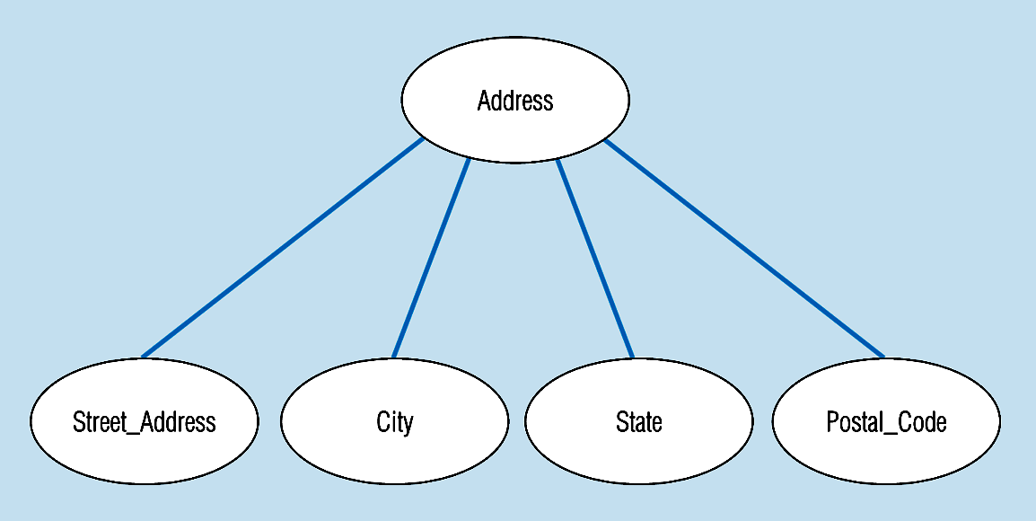
Figure 3-7 -- A composite attribute
An attribute broken into component parts
© Prentice Hall, 2002
Notes:
12

Slide 14

Figure 3-9a – Simple key attribute
The key is underlined
© Prentice Hall, 2002
Notes:
14

Slide 15
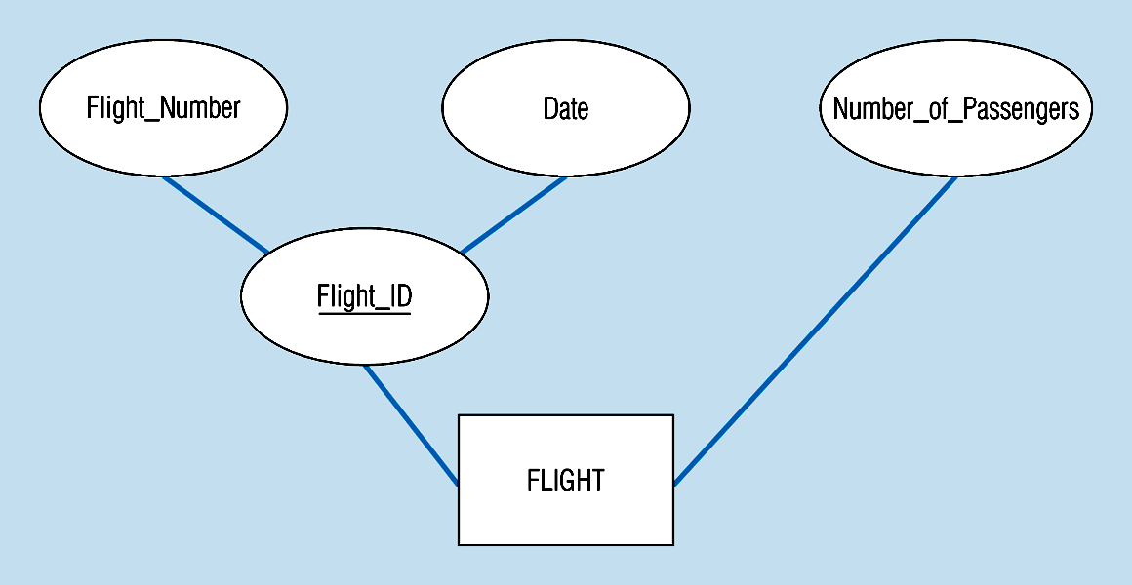
Figure 3-9b -- Composite key attribute
The key is composed
of two subparts
© Prentice Hall, 2002
Notes:
15

Slide 16
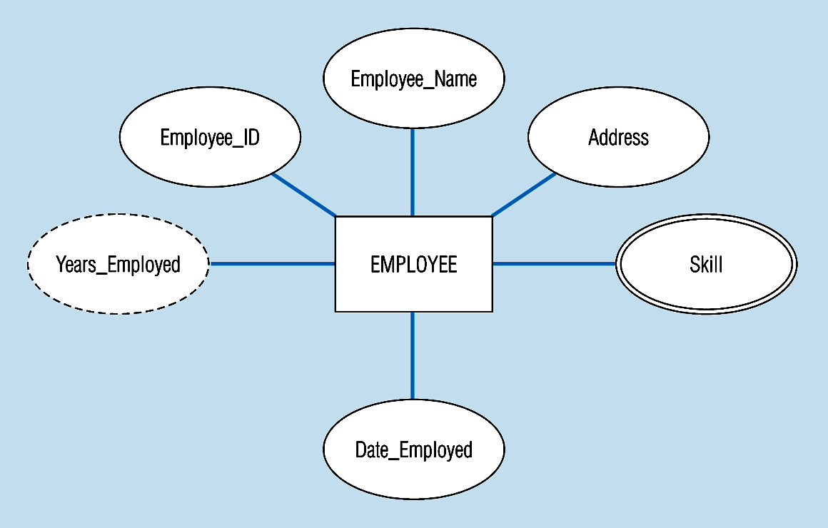
Figure 3-8 -- Entity with a multivalued attribute (Skill) and derived attribute (Years_Employed)
What’s wrong with this?
Multivalued:
an employee can have
more than one skill
Derived
from date employed and current date
© Prentice Hall, 2002
Notes:
13

Slide 17
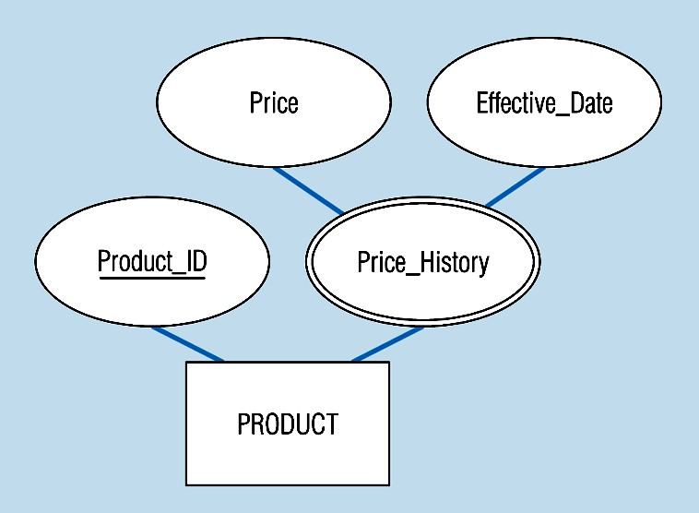
Figure 3-19 – an attribute that is both multivalued and composite
This is an example of time-stamping
© Prentice Hall, 2002
Notes:
37

Slide 18
Identifiers (Keys)
Identifier (Key) - An attribute (or combination of attributes) that uniquely identifies individual instances of an entity type
Simple Key versus Composite Key
Candidate Key – an attribute that could be a key…satisfies the requirements for being a key
© Prentice Hall, 2002
Notes:
6

Slide 19
Identifier
An attribute (or a joint set of attributes) which uniquely identify the entity instances of an entity
An identifier should be:
  Unique and known (must not be ‘NULL’)
  Short (preferably)
  Stable (preferably)
© Prentice Hall, 2002

Slide 20
What would you choose as the Identifier of the entity type EMPLOYEE?
EMPLOYEE
EMP-ID SS-NUM EMP- NAME PHONE
© Prentice Hall, 2002

Slide 21
Relationships
An association between two or more entities, of significance to the enterprise
SHIP
SUPPLIER
PART
WORK FOR
EMPLOYEE
COMPANY
© Prentice Hall, 2002

Slide 22
More on Relationships
Relationship Types vs. Relationship Instances
  The relationship type is modeled as the diamond and lines between entity types…the instance is between specific entity instances
Relationships can have attributes
  These describe features pertaining to the association between the entities in the relationship
Two entities can have more than one type of relationship between them (multiple relationships)
Associative Entity = combination of relationship and entity
  More on this later
© Prentice Hall, 2002

Slide 23
Degree of Relationships
Degree of a Relationship is the number of entity types that participate in it
  Unary Relationship
  Binary Relationship
  Ternary Relationship
© Prentice Hall, 2002
Notes:
16

Slide 24
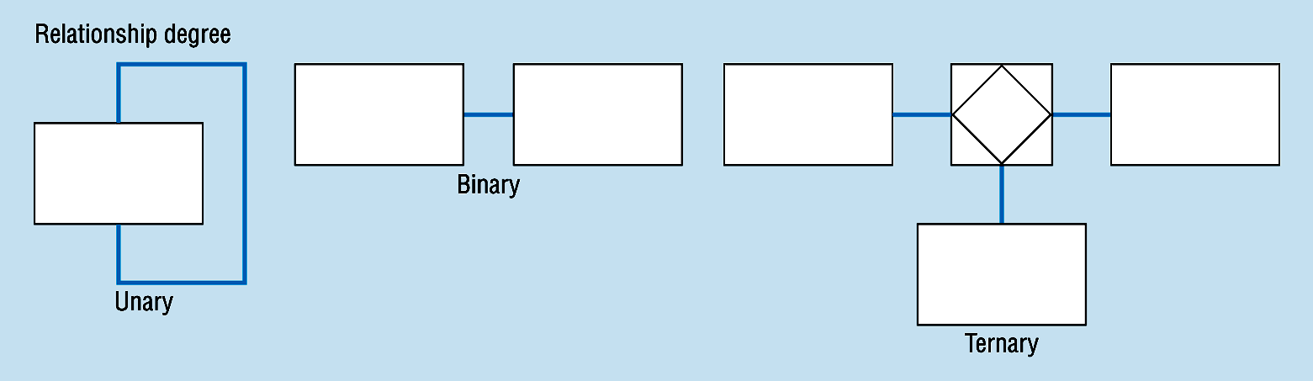
Degree of relationships – from figure 3-2
One entity related to another of the same entity type
Entities of two different types related to each other
Entities of three different types related to each other
© Prentice Hall, 2002
Notes:
8

Slide 25
Cardinality Constraints
A binary relationship (E₁,E₂) has two directions, left and right
Each direction has cardinality constraints, described as maximum and mimimu.
© Prentice Hall, 2002

Slide 26
Cardinality Constraints
Cardinality Constraints - the number of instances of one entity that can or must be associated with each instance of another entity.
Maximum Cardinality (can be)
  The maximum number
Minimum Cardinality (must be)
  If zero, then optional
  If one or more, then mandatory
© Prentice Hall, 2002
Notes:
29

Slide 27
Cardinality of Relationships
One – to – One
  Each entity in the relationship will have exactly one related entity
One – to – Many
  An entity on one side of the relationship can have many related entities, but an entity on the other side will have a maximum of one related entity
Many – to – Many
  Entities on both sides of the relationship can have many related entities on the other side
© Prentice Hall, 2002

Slide 28
Cardinality Constraints
Cardinality Constraints - the number of instances of one entity that can or must be associated with each instance of another entity.
Minimum Cardinality
  If zero, then optional
  If one or more, then mandatory
Maximum Cardinality
  The maximum number
© Prentice Hall, 2002
Notes:
29

Slide 29
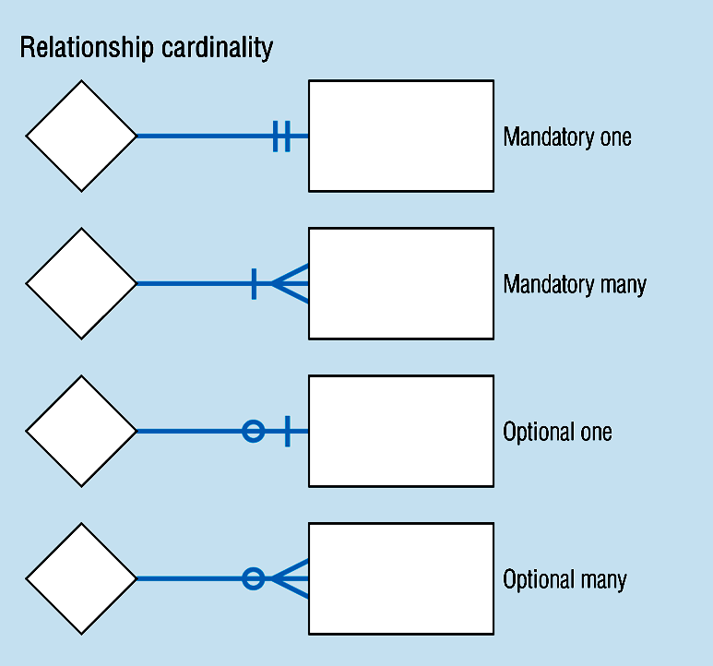
Cardinality – figure 3-2
© Prentice Hall, 2002
Notes:
8

Slide 30
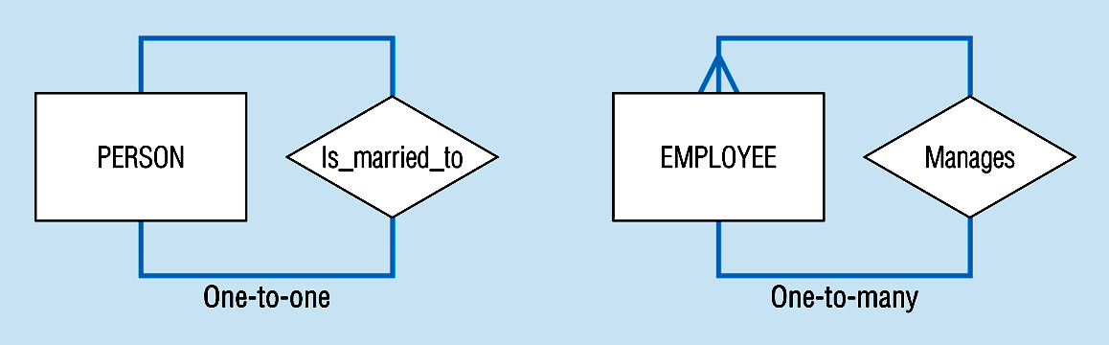
Unary relationships -- figure 3-12a
© Prentice Hall, 2002
Notes:
22

Slide 31
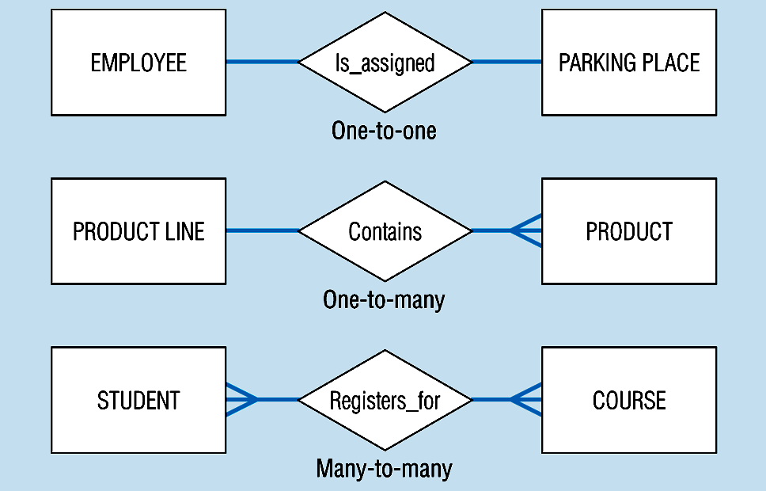
Binary relationships – figure 3-12b
© Prentice Hall, 2002
Notes:
23

Slide 32
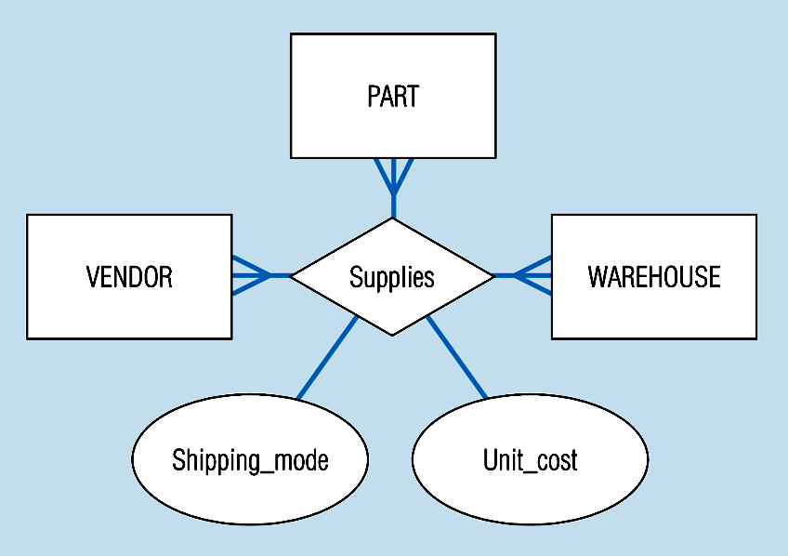
Ternary relationships –figure 3-12c
Note: a relationship can have attributes of its own
© Prentice Hall, 2002
Notes:
24

Slide 33

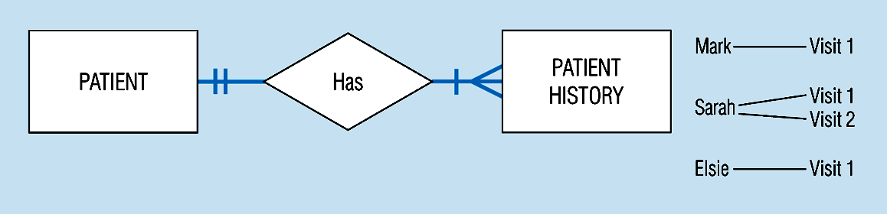
Basic relationship with only maximum cardinalities showing –
figure 3-16a
Mandatory minimum cardinalities – figure 3-17a
© Prentice Hall, 2002
Notes:
1

Slide 34
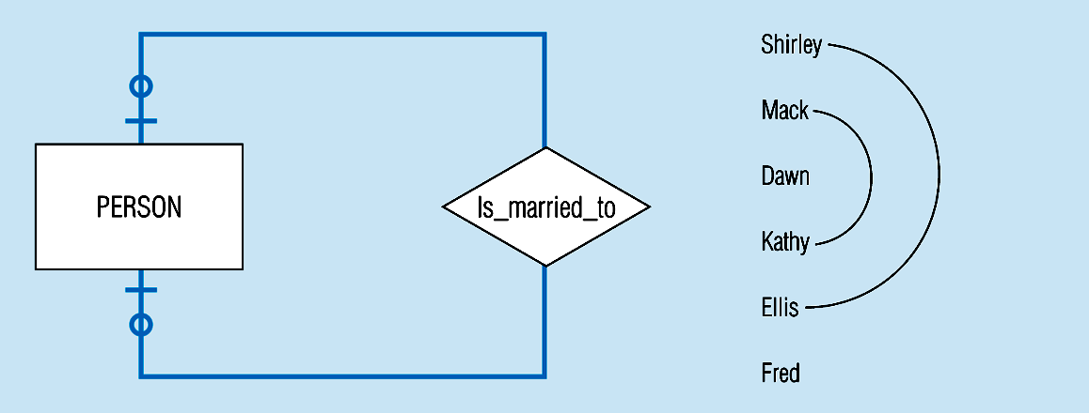
Figure 3-17c
Optional cardinalities with unary degree, one-to-one relationship
© Prentice Hall, 2002
Notes:
34

Slide 35
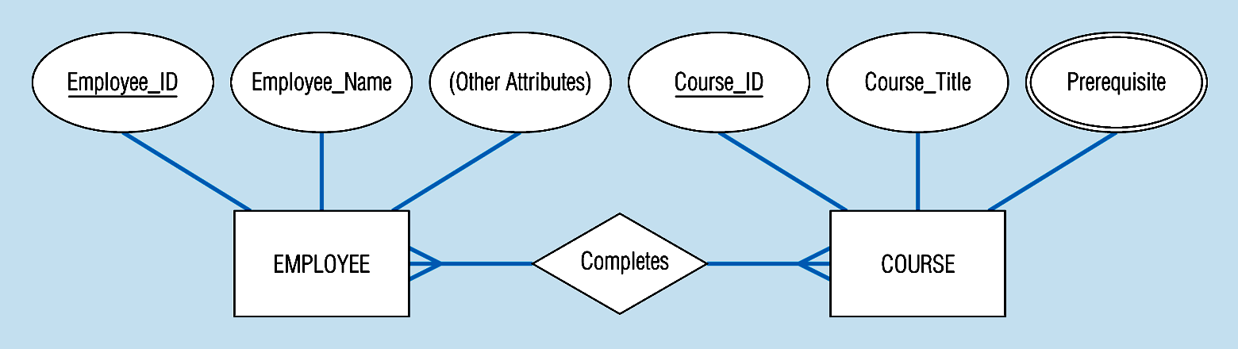
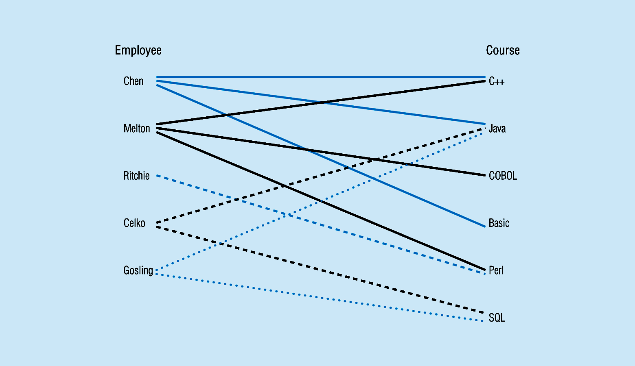
Figure 3-10a Relationship type
3-10b Entity and Relationship instances
© Prentice Hall, 2002
Notes:
17

Slide 36
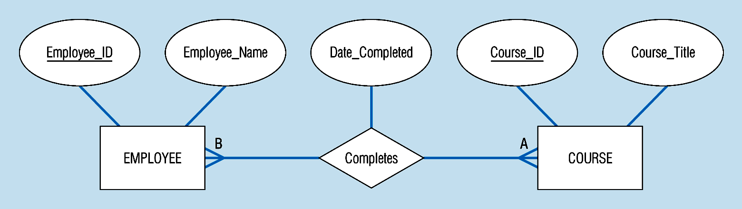
Figure 3-11a A binary relationship with an attribute
Here, the date completed attribute pertains specifically to the employee’s completion of a course…it is an attribute of the relationship
© Prentice Hall, 2002
Notes:
20

Slide 37
Figure 3-12c -- A ternary relationship with attributes
© Prentice Hall, 2002
Notes:
24

Slide 38
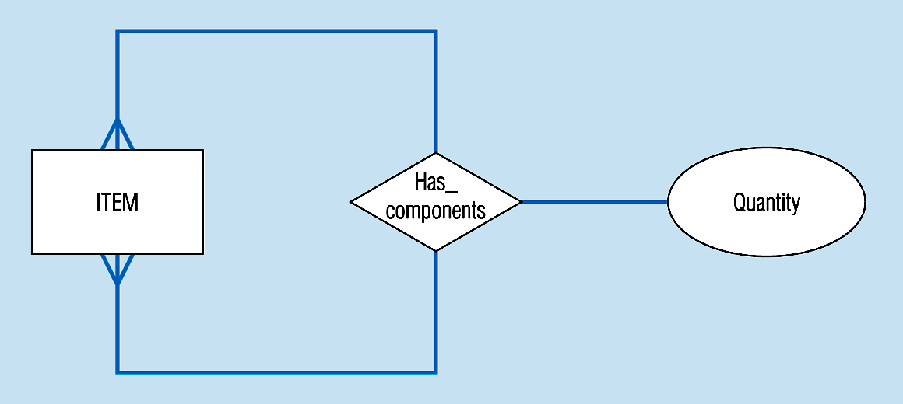
Figure 3-13a A unary relationship with an attribute. This has a many-to-many relationship
Representing a bill-of -materials structure
© Prentice Hall, 2002
Notes:
25

Slide 39
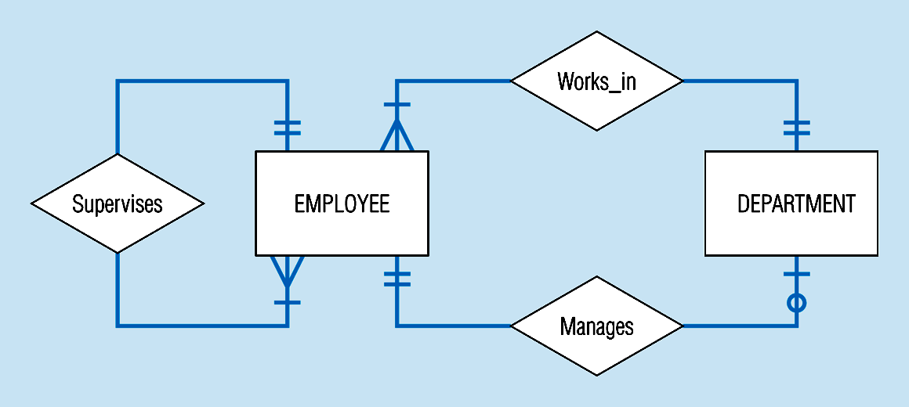
Examples of multiple relationships – entities can be related to one another in more than one way
Figure 3-21a Employees and departments
© Prentice Hall, 2002
Notes:
40

Slide 40
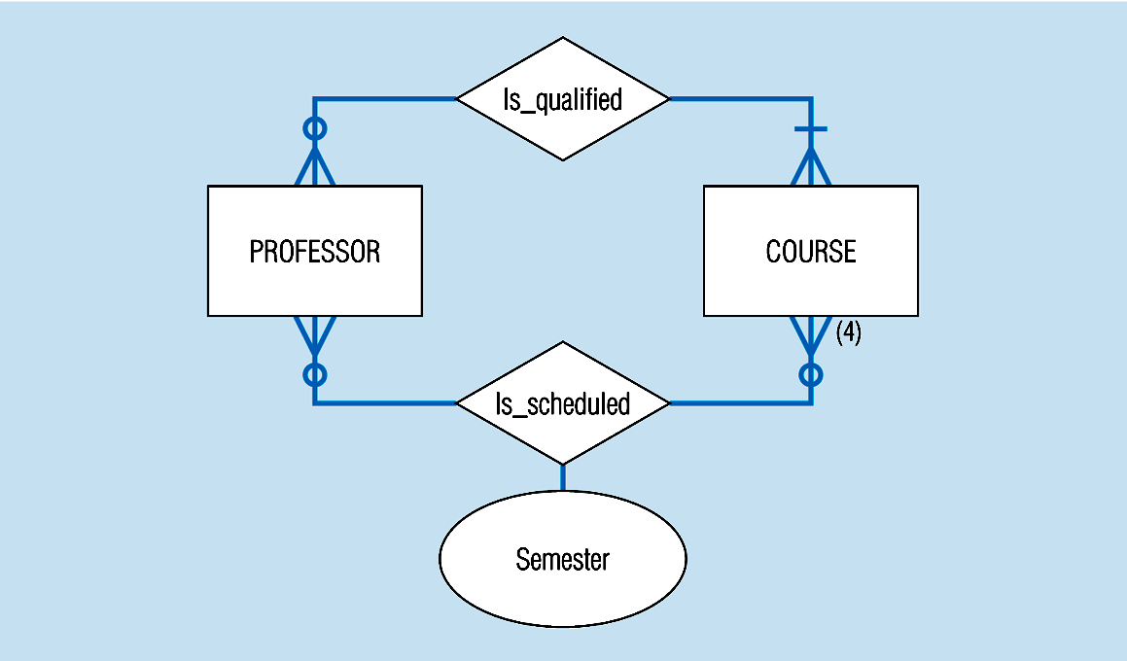
Figure 3-21b -- Professors and courses (fixed upon constraint)
Here,max cardinality constraint is 4
© Prentice Hall, 2002
Notes:
41

Slide 41
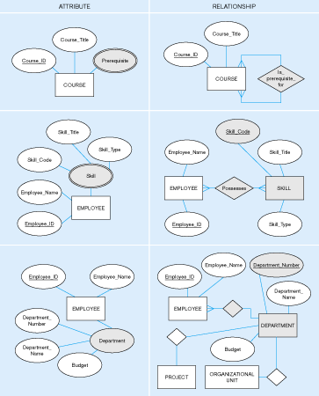
Figure 3-15: Multivalued attribute vs. relationship. Alternative approaches
© Prentice Hall, 2002

Slide 42
Dependent and Independent Entities
Entity B is existence-dependent on entity A when
  Some instance of A must exist before B can exist
  If A ceases to exist, B must also cease to exist
An independent entity is not existence-dependent on any other entity
Independent Entity – Strong Entity
Dependent Entity – Weak Entity
Diagramming convention
© Prentice Hall, 2002

Slide 43
Strong vs. Weak Entities, and
Identifying Relationships
Strong entities
  exist independently of other types of entities
  has its own unique identifier
  represented with single-line rectangle
Weak entity
  dependent on a strong entity…cannot exist on its own
  Does not have a unique identifier
  represented with double-line rectangle
Identifying relationship
  links strong entities to weak entities
  represented with double line diamond
© Prentice Hall, 2002

Slide 44
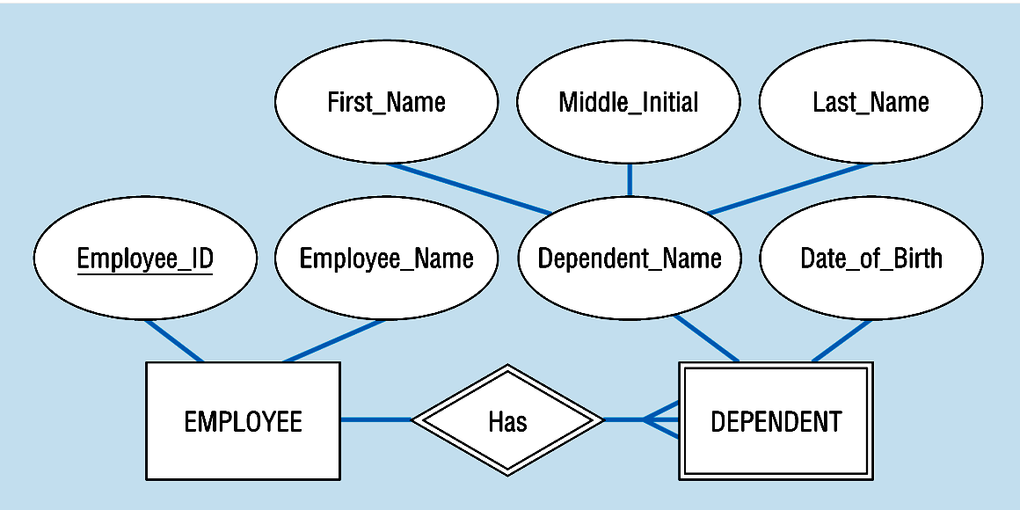
Figure 3-5: Strong and weak entities
Strong entity
Identifying relationship
Weak entity
© Prentice Hall, 2002

Slide 45
Associative Entities
It’s an entity – it has attributes
AND it’s a relationship – it links entities together
When should a relationship with attributes instead be an associative entity?
  All relationships for the associative entity should be many
  The associative entity could have meaning independent of the other entities
  The associative entity preferably has a unique identifier, and should also have other attributes
  The associative may be participating in other relationships other than the entities of the associated relationship
  Ternary relationships should be converted to associative entities (p102)
© Prentice Hall, 2002

Slide 46
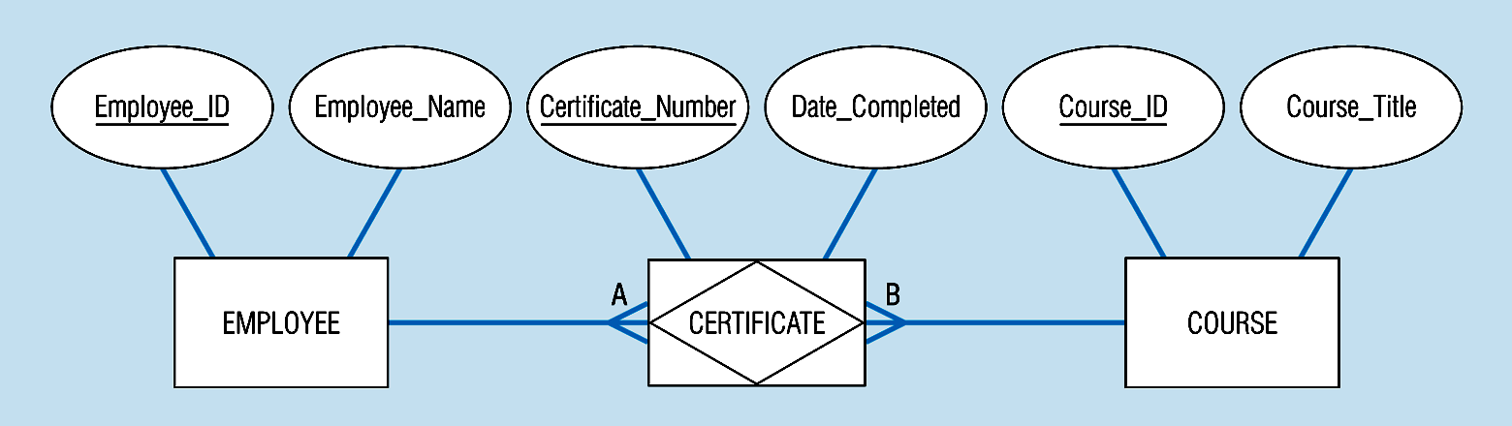
Figure 3-11b: An associative entity (CERTIFICATE)
Associative entity involves a rectangle with a diamond inside.
Note that the many-to-many cardinality symbols face toward the associative entity and not toward the other entities
© Prentice Hall, 2002
Notes:
21

Slide 47
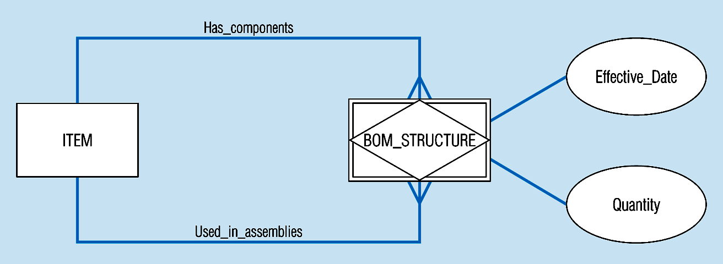
Figure 3-13c -- an associative entity – bill of materials structure
This could just be a relationship with attributes…it’s a judgment call
© Prentice Hall, 2002
Notes:
27

Slide 48
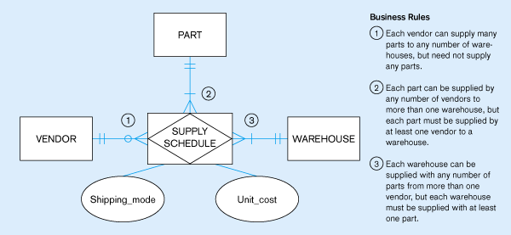
Figure 3.18 -- Ternary relationship as an associative entity
© Prentice Hall, 2002
Notes:
36

